Slide 1
Ontology Matching Visualization
WCP Committee
Chair: Dr. Andrew Johnson
Advisor: Dr. Isabel Cruz
Dr. Jon A. Solworth
Written Critique and Proposal
Presented by: Vivek R. Shivaprabhu
April 26, 2017

Slide 2
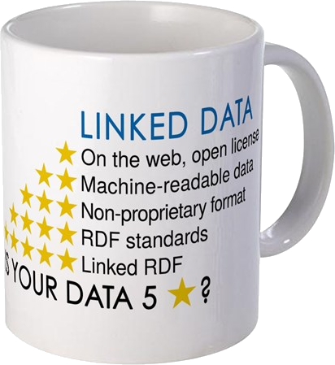
Introduction
Semantic Web: extension of the Web through standards by W3C.
A common framework that allows data to be shared and reused across application, enterprise, and community boundaries.
“This simple idea…remains largely unrealized”
– Tim Berners-Lee, 2006
Notes:
Linked Data: a method of publishing structured data so that it can be interlinked and become more useful through semantic queries.
Linked Data in the semantic web is considered as a standardized approach to achieve automated interoperability of heterogeneous systems/applications.
In 2013, 4M Web domains contained Semantic Web markup. In 2015, there were 285M registered domains. 875M websites.

Slide 3
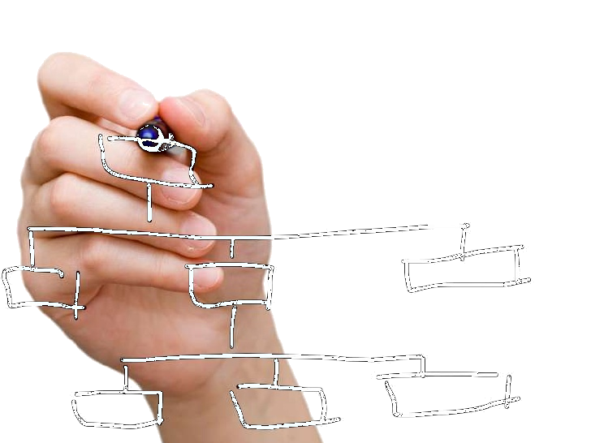
Ontology
An ontology is a formal, explicit specification of a shared conceptualization.
What entities exist or may be said to exist?
How may such entities be grouped?
How may they be related within a hierarchy?
Subdivided according to similarities and differences?
There is no gold standard to represent concepts and relationships (by design)
Prevents interoperability between various open and proprietary standards.
Notes:
It is highly hypothetical, but has practical applications in Data Science.

Slide 4
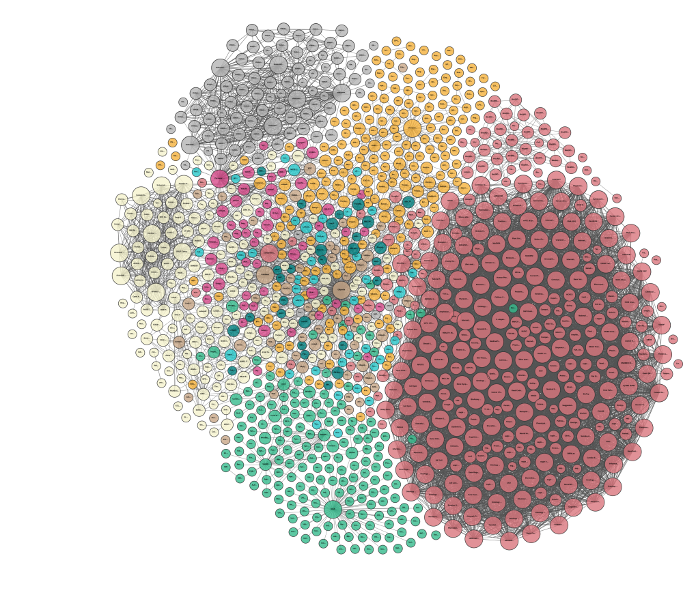
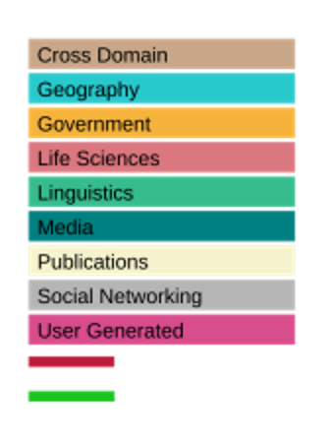
Linked Open Data
Last updated: 2017-02-20
# Datasets: 1139
Cumulative numbers:
9960 datasets
149 billion triples
Problems with
6971 datasets (70.1%)
http://lod-cloud.net

Slide 5
Ontology Matching
The process of matching ontological knowledge in general.
Find classes of data that are semantically equivalent (ex: Truck and Lorry).
aka, Instance Matching, Record Linkage, Entity Resolution, Deduplication, Merge-Purge, Entity-Identification, Object Identification, Identity Resolution, Data Fusion
Usually performed semi-automatically.
Tools function over entity-relationship models, database and XML schemata, taxonomies, formal languages, and label frameworks such as RDF/OWL.
Notes:
Ontology matching is associated with analogy formation, where concepts are variables in logic expressions.

Slide 6
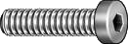
Ontology Matching – Components
Schema Matching
Instance Matching
Matching of concepts and properties represented by TBoxes of DL ontologies
Matching of assertions represented by ABoxes of DL ontologies
DB1.Product | DB2.Product
ID | Item Number
Description | Web Description
Brand Name | Trade Name
Material
 | Finish
Overall Length | OAL
¼-20 x 3/8 SS SHCS
Stainless Steel Socket Head Cap Screw, 1/4” Dia, 20 Thread Size, 3/8” Length
The set of correspondences is called Alignment

Slide 7
Ontology Mapping – Methods
Typically, ontology matching focuses on linking data that are labeled in the same natural language.
Similarity Based – Linguistic using syntax or semantics, and Contextual
Reasoning Based – Deductive, and Probabilistic
Learning Based – train a classifier
Sometimes, a gold standard – Reference Alignment – is available.
Cross-lingual ontology mapping: Process of establishing relationships among ontological resources from two or more independent ontologies where each ontology is labeled in a different language.
Notes:
If the source and target ontologies are in different languages, a lexical comparison is not possible.

Slide 8
Ontology Matching – Process
Designed to function over entity-relationship models, database and XML schemata, taxonomies, formal languages, and label frameworks such as RDF/OWL.
Employ automated alignment techniques to find matches.
Results are visualized for review or consumption.
Introducing a human in the loop to answer a small set of questions can help resolve conflicts across large datasets.
Visualization improves user experience in being able to better assimilate the relationships between concepts, and instances.
Notes:
It is intuitive to form analogous connections between objects by linking them visually and deriving rules.
They may want to group the concepts and/or reorder them based on various properties that are intrinsic to the data or derived from the results of the matchers.
Clustering and sorting concepts allows the user to recognize patterns and intuitively understand relationships between the concepts as well as the behaviors of the matchers in terms of how they prioritize the importance a (different) subset of features.

Slide 9
Cognitive Requirements
The process of writing explicit queries to look for patterns and validate mappings requires:
cognitive presence to anticipate specific types of patterns,
technical expertise to be able to construct the queries, debug any issues, interpret the results, and
iterate to look for other patterns.
A visual interface enables a follow-your-nose style of exploration:
users may navigate it seamlessly,
slice and dice the results, and
look for visual patterns that expose visual insights.
Notes:
The use of computer-aided, interactive visual representations of data amplifies cognition and enables the user to make intuitive decisions instead of having to mentally derive the correctness of each potential match offered by the alignment.

Slide 10
Visual Analytics – Sensemaking
Interactive visualization, data analytics and reasoning using cognitive approaches.
In most ontology matching implementations, visualization is an after-thought, or non-existent.
Sensemaking: how people make sense of unfamiliar visualizations.
Understanding this helps one design new and innovative visualization techniques.
Little research around based on user interaction and cognition of unknown visualization by novice users.
Notes:
Visual Analytics allows for the definition of different semantics than can be associated with the alignment, including atomic (one-to-one), subsumption, part-of, equivalence, disjointness or other user defined relationships.
There is copious literature regarding what kinds of tasks and activities conducted on visualization.
But there are only few of studies conducted on the topic of how a novice user makes sense of a visualization.

Slide 11
Visual Analytics – why visual?
User feedback as a “first-class citizen” of the ontology matching exercise.
Intuitive visualization allows the user to provide valuable feedback.
By soliciting this feedback, ontology matching systems can better understand the underlying data.
A seamless transition between visualization and interaction paradigms lets the user make decisions iteratively instead of relying complex queries to arrive at the desired outcomes.
Sophisticated Ontology Matching systems do not take the users’ situational needs into account.
Notes:
Several benefits may be drawn by evaluating various artifacts such as query, results, or mapping.
The application may require user inputs that define momentary preferences, but the users may not be able to express them upfront without looking at an initial set of intermediate results.
An interactive visualization tool will enable this explorative analysis and may not require any inputs from the user to get started on the matching exercise.

Slide 12

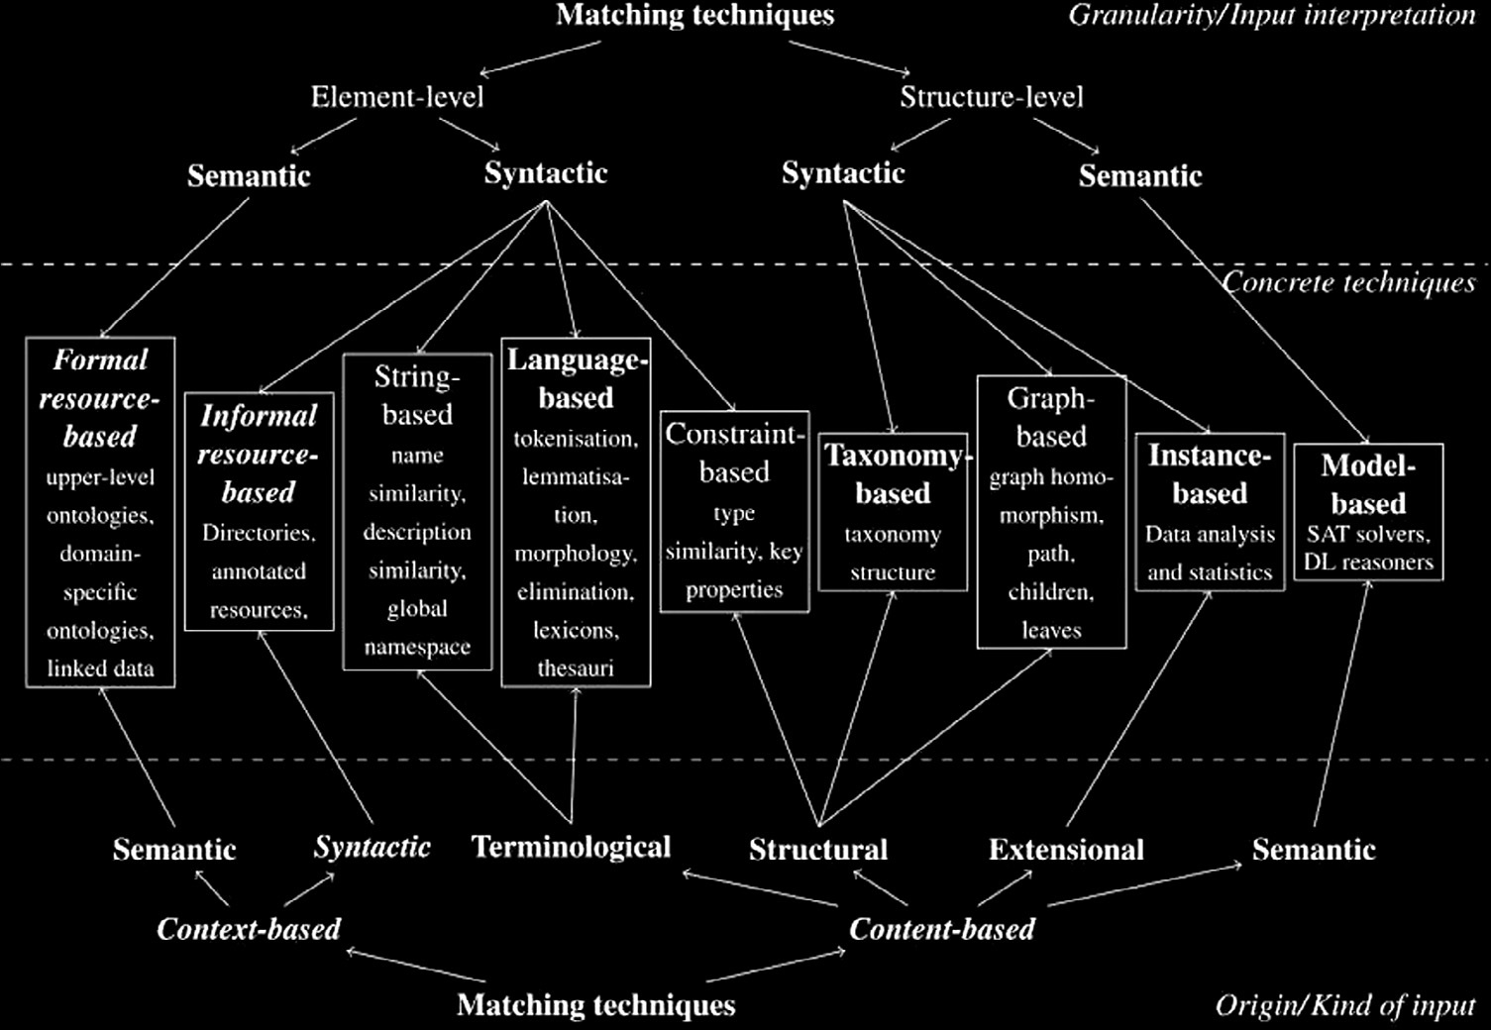





Ontology Matching
Visualization
Source Target
Intermediate
Results
Ontology
Matching
User Feedback
Alignment
SME

Slide 13
Visual Interface Types
Basic Principles
Display summaries first
Allow user to slice and filter
Item Detail on demand
Reviewing alignment using visual graphical user interfaces can be tricky:
Sources may report different values for the same attributes for the same entities.
Example: Geo Location
Temporal information related to some features may not be available.
Example: Population
Non-obvious relationships can be overlooked or may not be considered in the decision making process.
Notes:
Visual Analytics is based on Information Visualization whose main focus is to represent large conceptual datasets in a limited screen real-estate.
Being able to see these aspects of the matching process helps the user understand some of the idiosyncrasies embedded in the datasets.

Slide 14
Visual Interface Types
There is no one-size-fits-all visualization.
Multiple perspectives for the same dataset can only be useful if users can switch between views seamlessly.
As the number of data sources grow – and thus, the number of triples, aspects that may be been initially perceived as convenience attributes transform into essential features.
The ability to expand or collapse groups based on features becomes important.
Tools implement multiple views to visualize taxonomy-, schema- and entity-matching alignments.
Notes:
Points to ponder

Slide 15
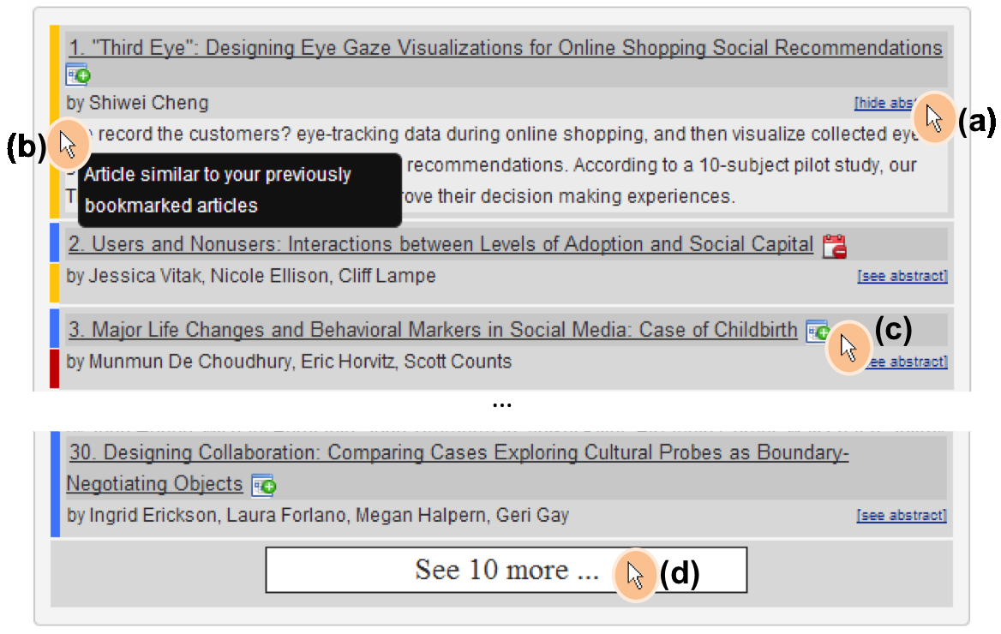
Tabular and List-based Representation
Most common representation of ontology matching alignment
Features of the entities or classes that make up the mapping are rendered in a list or table format.
Tool does not analyze or interpret the results, they are simply ‘printed as-is’.
User is expected to spend considerable energy to come up with opinions and/or interpretations of the data
non-visualization?
Notes:
A search interface allows the user to provide a set of filter criteria to narrow the list of entities to explore.
The user can then select two (or more) objects to be compared side-by-side, which are grouped together in a predicate-object style.
If the amount of data being presented is large, it might be hard to read and remember all the necessary information to come up with a well-informed unbiased opinion of what the data represents..
It is difficult to see patterns quickly, or be able to identify outliers that may or may not be errors in the data, without being able to “see” the data in the researcher’s own mind.

Slide 16
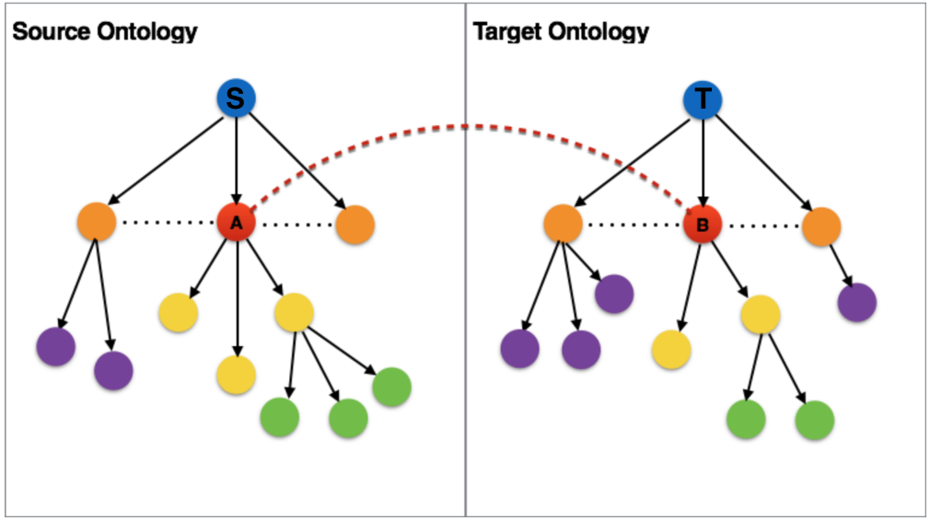
Linked Tree Widgets
Tree structures encode hierarchical data using connection or containment.
Highlights the parent-child relationships between nodes.
Typically used for taxonomies.
Child nodes at each level may represent a different attribute that may be user-selectable.
Maps may be between the source and target, or intra-ontology.
Notes:
They may be represented as
a graph, with edges that connect a parent concept to all of its children,
an indented list where the X-axis represents the tree depth and the Y-axis is used to separate the nodes, or
a circular graph where the R-axis represents tree depth and the θ-axis is used to separate the nodes.

Slide 17
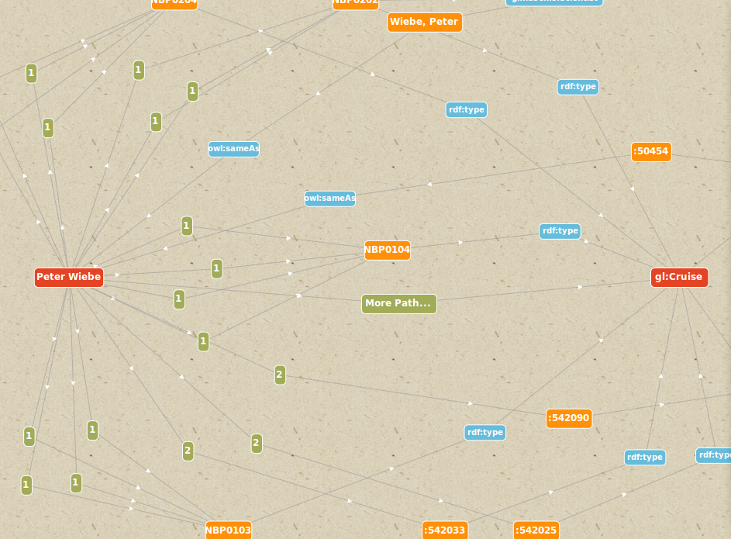
Cluster Visualization
Expansion of the tree view.
Nodes in a graph may represent entities.
Edges represents various types of relationships that may exist between the entities in the graph.
It is possible to select an entity as the source and another entity, schema-attribute or class as the destination.
Knowledge about the content affects graph comprehension.
Notes:
The system can then perform n-degree path queries to extract all objects along the path from source to target.
Choosing the right set of attributes to link the nodes based on, and picking a minimal set of fields that will be used as labels for the nodes and edges is critical.
Historical studies suggest that children should be involved in graphing activities to build and expand relevant schemata needed for comprehension.

Slide 18
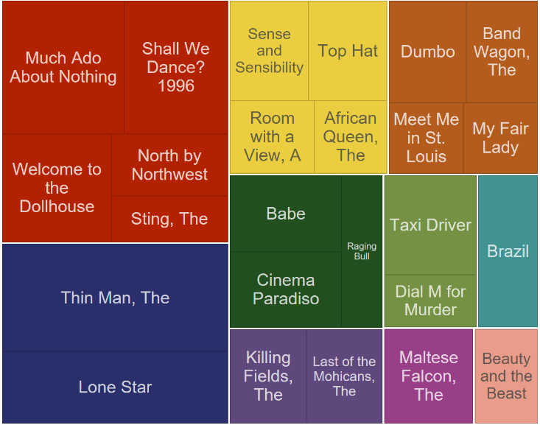
Tree-maps and Pie-Charts
Space-constrained overview of the class structure.
Use nested rectangles (in treemaps) or Sectors (in piecharts).
Large mono-hierarchical tree-structured data.
Great space efficiency and high readability.
Size, Color, and Opacity of objects may represent various features/dimensions of the object.
Algorithm may be slow, depending on the size of the dataset.
Notes:
A guided navigation that displays detail information as the user navigates the hierarchy.
They may use zoom-in animations to view detail for a selected object.
This view is best suited if there are multiple potential matches for a given source entity and when they can be represented as a set of hierarchical or complementary alternatives for a user selection.

Slide 19
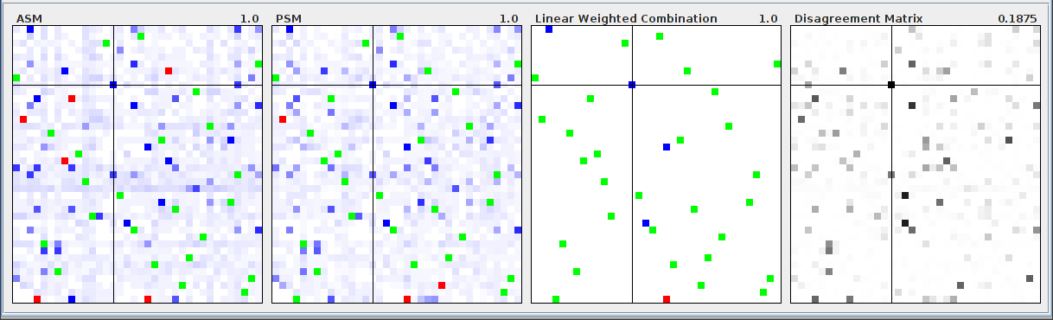
Matrix Views
These can show classes from source and target ontologies along the axes of a matrix, with the alignment represented as pixels within the matrix.
Multiple linked matrix views may represent various matching algorithms.
Effective when looking at the big picture to gain insights about the alignment space.
The entire mapping space may be visible.
May be too noisy or too barren.
Notes:
Since every potential match in the alignment is visualized in the matrix views, the visualization may come off as being too noisy or too barren in some circumstances.
If the number of classes are in the hundreds or thousands, there may not be enough screen real estate to be able render all mappings.
The intelligent use of filters and ordering can help alleviate some of these concerns.

Slide 20
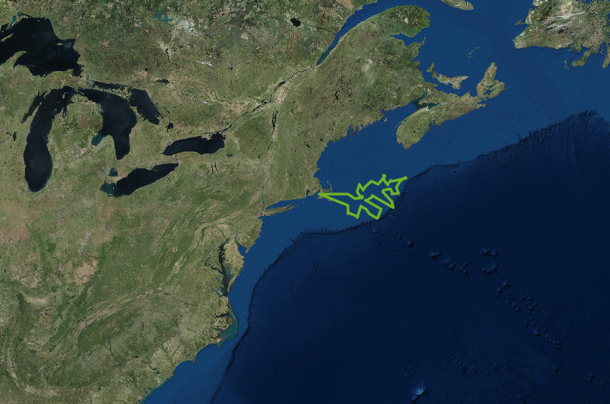
Multi-layer Map-based Visualization
Classes and Instances that have geospatial attributes associated with them may be visualized using maps that can be represented using sprites on multiple layers.
May use multiple layers – terrain contours, land-use based sprites, streets, buildings, etc.
Can be effective in representing spatial and temporal relationships between objects.
Can be distracting.
Notes:
Instances from source and target ontologies may be represented using different sprites.
Care has to be take to include just enough background data to enhance the user experience without influencing the decision-making process.

Slide 21
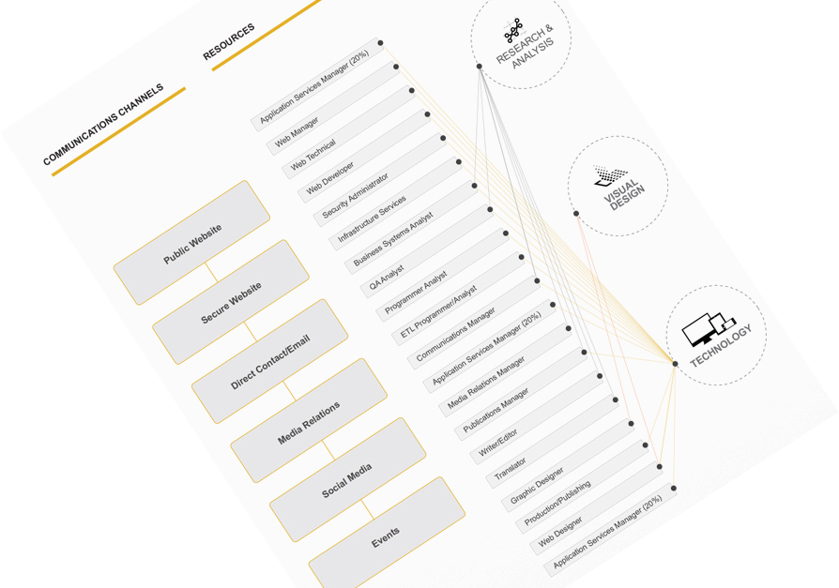
Others
Parallel Co-ordinates Plots
Chord Diagrams
Flow-based matcher representations
and so on…

Slide 22
Visualization Sensemaking
Uptick in the variety of the visualizations that are presented to the general public.
Intelligence analysis is considered a form of sensemaking and expert skill.
Experts build a set of intuitive patterns, also known as schemas, around the important elements of their tasks over time from extensive experience.
Not applicable to a novice user.
A Novice User is defined as a person who is seeing a particular type of visualization for the first time.
Notes:
However, this model does not focus on novice users, who have never looked at a given visualization.

Slide 23
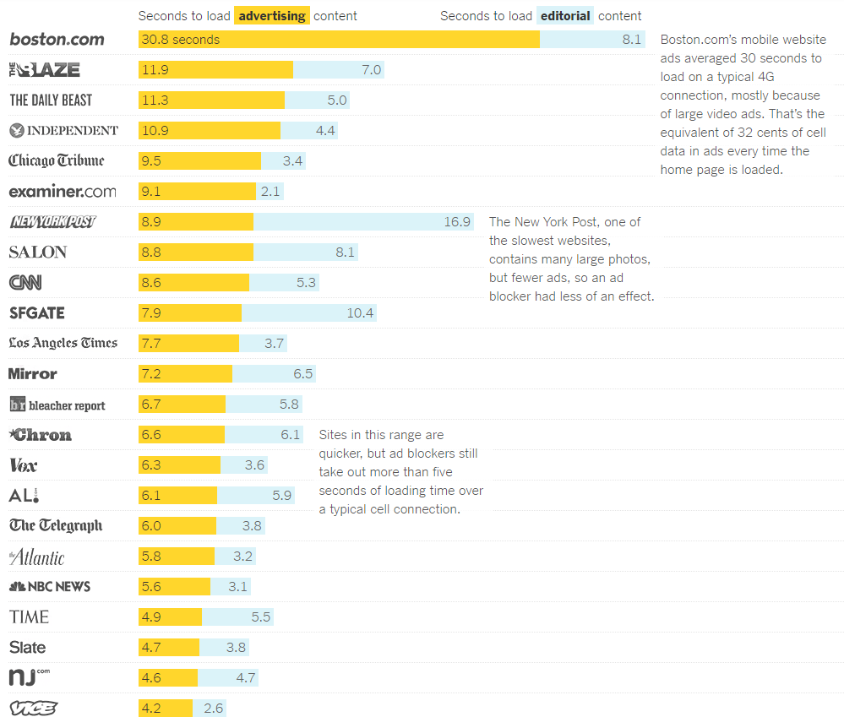
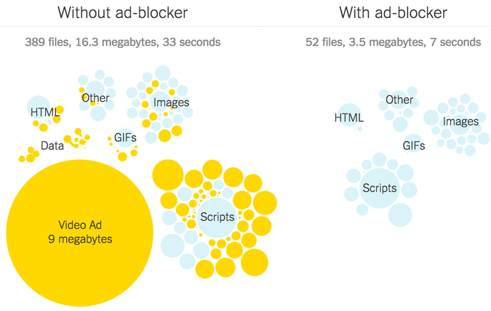
For example: The cost of mobile advertisements on 50 news websites

Slide 24
Visualization Sensemaking
Information Visualization Sensemaking refers to the “conscious efforts to achieve understanding of how to interpret visual objects and underlying content in an information visualization”.
Data-frame theory postulates that “elements are explained when they are fitted into a structure that links them to other elements”.
Depending on the data – the interpreted signals of events – people refine the existing frame – the explanatory structures that account for the data – or construct a new frame based on the sensemaking activities.

Slide 25
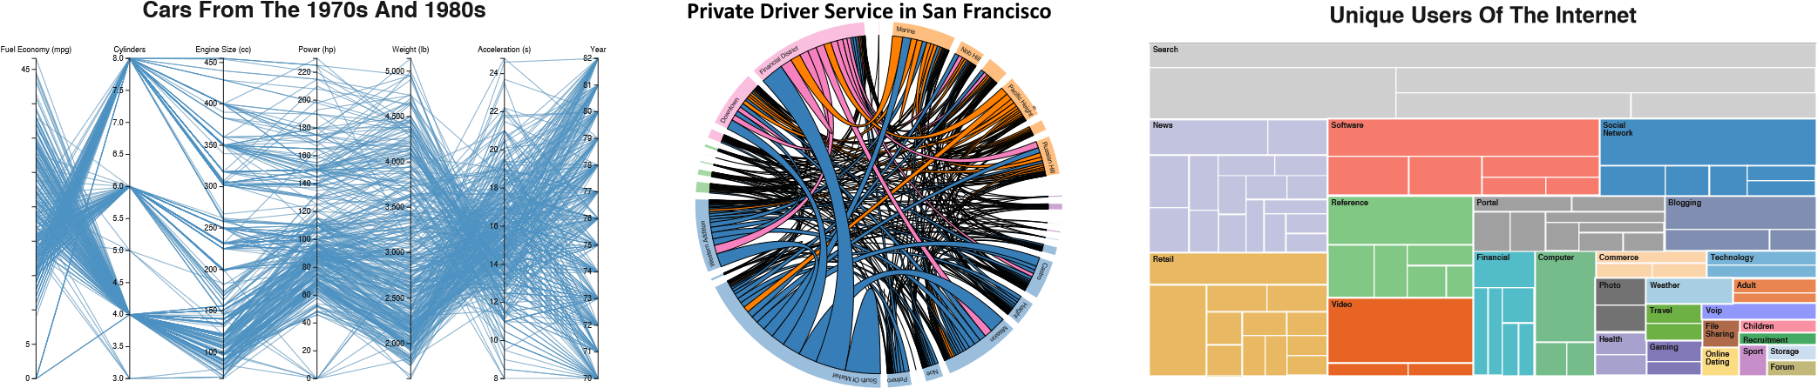
Unknown Visualizations for Novice Users
parallel-coordinates plot chord diagram treemap
multivariate data network data hierarchical data

Slide 26
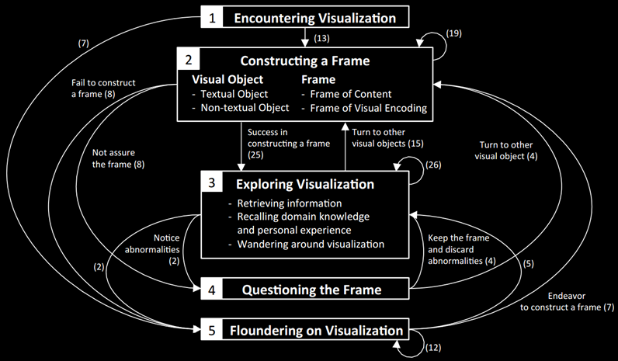
NOvices information VIsualization Sensemaking (NOVIS) model
The arrows indicate the major transitions between the five activities and the numbers in the parentheses indicate the number of transitions between the activities that were observed from the data.
Notes:
Encountering Visualization is the cognitive activity in which a user looks at a whole image of an information visualization. Users do not actively try to make sense of the visualization yet, but they build an initial set of impressions about what they are seeing during this activity.
Constructing a frame is the process where the user attempts to construct a frame to make sense of the given visualization. Participants attempted to construct two types of frames – frame of content using textual objects such as title, axis labels, etc, and frame of visual encoding by conjecturing what each object in the visualization meant. Sometimes, they constructed incorrect frames, but they relied on it explore the visualization which negatively influenced further sensemaking activities.
Exploring Visualization is the cognitive activity where the user interacts with the tool to discover facts and gain insights from the visualization based on the constructed frames. This process may be classified into three distinct, but overlapping tasks: • Participants retrieved various information while exploring the visualization by interpreting labels and non-textual objects. • They recalled domain knowledge and/or personal experience, which may not gain any new insights, but helps define next steps in the exploratory process. • Participants read text and other objects in no specific order; this wandering is based on the frame that they built previously and what they thought they were looking for.
Questioning the frame is the process in which the user begins to doubt the constructed frame or tries to verify the frame. This happens when they encounter uncertain or abnormal visual objects that may not be compatible with the frame while exploration.
Floundering on Visualization happens when the user was unable to construct a reasonable frame and does not know what to do with the information visualization, which may lead to them being frustrated or confused. Contrary to wandering around the visualization, the user is not constructive about enhancing their frame; instead they feel like they have reached a dead end.
Miscellaneous: In addition to these clearly identifiable stages, participants exhibited minor quibbles that include positive or negative comments, recommendations on how to improve the visualization or suggestions for new representations.

Slide 27
Sensemaking dynamics
Participants floundered much less with treemap than chord diagram or the parallel coordinates plot.
Most time was spent in questioning the frame with the chord diagram.
Slightly different path for different visualizations.
Some went back from floundering to exploring the visualization
Others went from questioning a frame to constructing a new frame or to exploring the visualization.
Some participants gleaned visual objects from the visualization and made efforts to construct a frame.

Slide 28
Sensemaking dynamics
Incorrect frames of content and visual encoding cause confusion in exploring the visualization.
May lead to floundering and finally giving up.
Users gave up on the parallel-coordinates plot (5 attempts) much sooner than trying to figure out the chord diagram (18 attempts).
Users tend to assign meanings on colors even though there may not be any particular meaning associated with it.
The content may arouse emotions – positive or negative, which may sway the experience.

Slide 29
Conclusions
The purpose of the visualization is not the picture themselves, but the rapid information assimilation, i.e., to provide insight.
The use of overview + detail or focus + context in the visualization provides visual transfer functions that can be used to specify complex variations of magnification across displays.
Introducing a human in the loop in the decision making process using intuitive interactive visualizations enable matching processes to generate high quality mappings.
Research about understanding users’ cognitive activities should be actively conducted to develop novel information visualization techniques that are comprehensible and exposes the story from the underlying data.
Notes:
Computer-based interactive visualizations facilitate the cognition of abstract data.
Today’s ontology matching algorithms are sophisticated, but they cannot take users’ momentary needs that may deviate from global preferences.
Linked data driven, multiple linked view interfaces allow users to gain insights across different repositories.

Slide 30
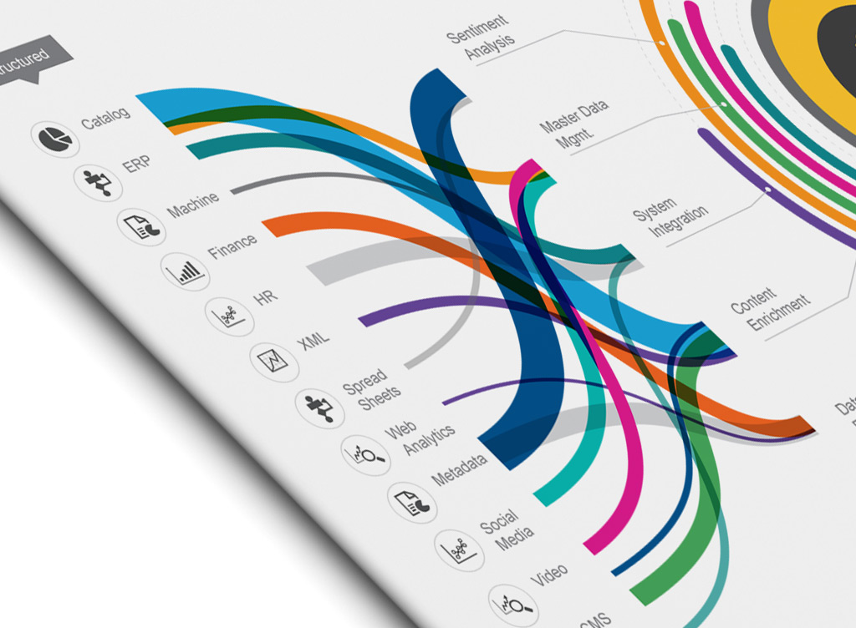
Thank You!
Q & A
Full Report:
http://www.vivekrs.com/DataScience/OntologyMatchingVisualization/report.pdf

